Slide 1
Supply Chain Management Unit 4 – Synchronous SCM
Venkadeshwaran K
Associate Professor
School of Mechanical Engineering
FET, JAIN (Deemed to be University)

Slide 2
Introduction
In conventional supply chains each stage in the chain tends to be disconnected from the others.
effect of this is that end-to-end pipeline times are long, responsiveness is low and total costs are high.
To overcome these problems it is clear that the supply chain needs to act as a synchronised network – not as a series of separate islands.

Slide 3
Introduction
Synchronisation implies that each stage in the chain is connected to the other and that they all ‘march to the same drumbeat’. The way in which entities in a supply chain become connected is through shared information.
To enable this degree of visibility and transparency, synchronisation requires a high level of process alignment, which itself demands a higher level of collaborative working.

Slide 4
PRCOESSES in various links of SCM
Planning and scheduling: Material positioning/visibility, advanced planning, scheduling, forecasting, capacity management.
Design: Mechanical design, electrical design, design for supply chain, component selection.
New product introduction: Bill of materials management, prototyping, design validation, testing, production validation, transfer to volume.
Product content management: Change generation, change impact assessment, product change release, change cut-in/phase-out.
Order management: Order capture/configuration, available to promise, order tracking, exception management.
Sourcing and procurement: Approved vendor management, strategic sourcing, supplier selection, component selection.

Slide 5
STEPS TO SYNCHRONIZE A SUPPLY CHAIN
Diagram the supply chain from raw materials to the end customer.
Prepare a master list of stock-keeping units (SKUs).
Pareto the SKU list by revenue (or by contribution margin).
Determine the trading partner node capacity required for synchronization over the expected range of de­mand uncertainty.
•Identify the trading partner who is the system constraint.
Establish the days of supply for the constraint buffer and the shipping buffer.
Properly thread the demand signal to avoid the bullwhip effect.

Slide 6
STEPS TO SYNCHRONIZE A SUPPLY CHAIN
Use collaborative push planning system to set the incoming rate of materials.
Use statistical safety stock on unique materials to support mix variation.
Define the operating rules at the push/pull boundary.
Spend supply chain resources to minimize the larg est standard deviation among supply uncertainty, cycle time variation, and transit time variation.
Maintain operational alignment through global per­ formance measures.
Hold periodic supply chain operations council meet­ings to resolve issues.

Slide 7
The extended enterprise and the virtual supply chain
The nature of business enterprise is changing. Today’s business is increasingly ‘boundaryless’, meaning that internal functional barriers are being eroded in favour of horizontal process management and externally the separation between vendors, distributors, customers and the firm is gradually lessening. This is the idea of the extended enterprise, which is transforming our thinking on how organisations compete and how value chains might be reformulated.

Slide 8
The extended enterprise and the virtual supply chain
Underpinning the concept of the extended enterprise is a common information ‘highway’. It is the use of shared information that enables cross-functional, horizontal management to become a reality. Even more importantly it is information shared between partners in the supply chain that makes possible the responsive flow of product from one end of the pipeline to another. What has now come to be termed the virtual enterprise or supply chain is in effect a series of relationships between partners that is based upon the value-added exchange of information. Figure 2 illustrates the concept.

Slide 9
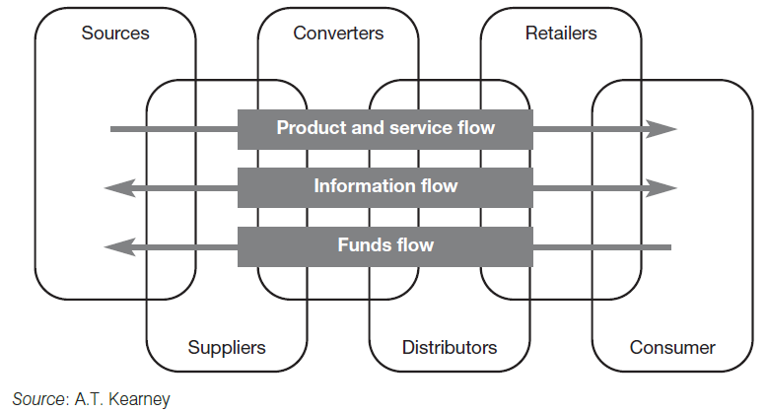
The extended enterprise and the virtual supply chain

Slide 10
The extended enterprise and the virtual supply chain
Underpinning the concept of the extended enterprise is a common information ‘highway’. It is the use of shared information that enables cross-functional, horizontal management to become a reality.
supply chain is becoming a confederation of organisations
This process is being accelerated as the trend towards outsourcing continues.

Slide 11
The role of information in the virtual supply chain
key to success in supply chain management is the information system.
New dimension of information- supply and demand to be matched in multiple markets, often with tailored products, in ever-shorter time-frames.
In the marketspace, customer demand can be identified as it occurs and, through CAD/CAM and flexible manufacturing, products created in minimal batch sizes.
Internet has in many ways transformed the ways in which supply chain members can connect with each other.
Extranets as they have come to be termed are revolutionising supply chain management.

Slide 12
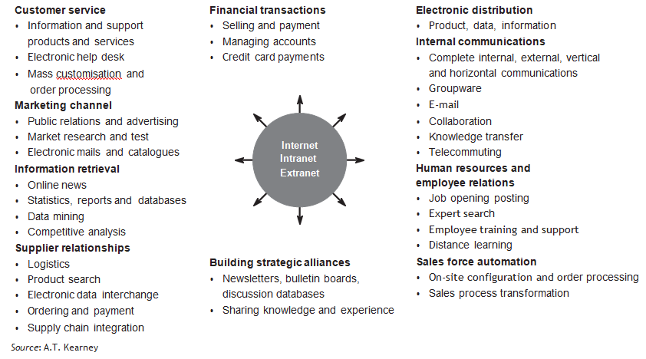
Internet applications and the supply chain

Slide 13
Increasingly, it seems that successful companies have one thing in common – their use of information and information technology to improve customer responsiveness.
emergence of integrated logistics systems that link the operations of the business, such as production and distribution, with the supplier’s operations on the one hand and the customer on the other.
these systems has the potential to convert supply chains into demand

Slide 14
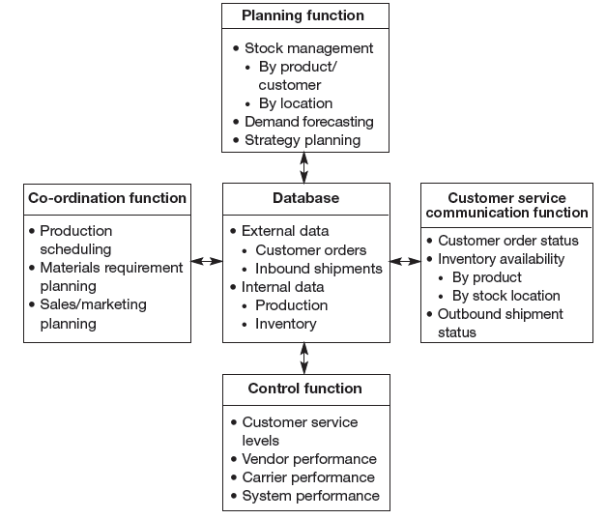
Functions of a logistics information system

Slide 15
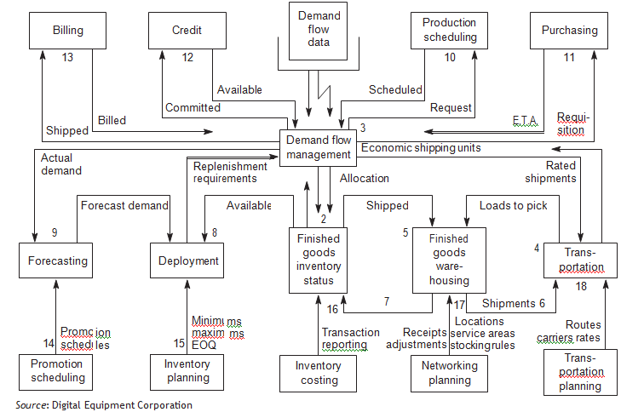
An integrated logistics information system

Slide 16
Laying the foundations for synchronisation
conventional wisdom in production and manufacturing is to seek economies of scale through larger batch quantities,
Clearly such an approach runs counter to the requirements of a synchronous supply chain.
The basic principle of synchronisation is to ensure that all elements of the chain act as one,
In a synchronous supply chain the management of in-bound materials flow becomes a crucial issue
The idea of ‘stockless distribution centres’ or ‘cross-docking’ enables a more frequent and efficient replenishment of product from manufacture to individual stores

Slide 17
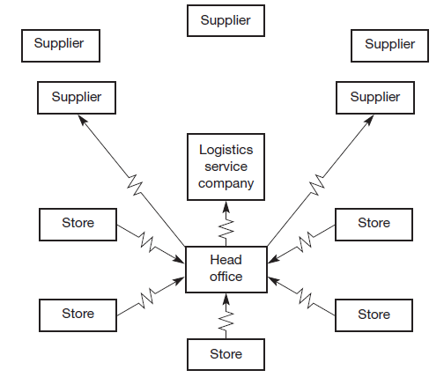
Laying the foundations for synchronisation
Figure 6 Daily sales data drives the replenishment order system

Slide 18
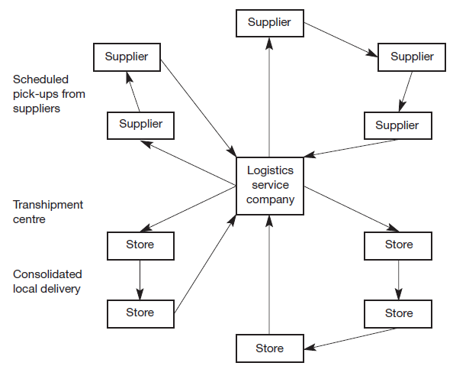
Laying the foundations for synchronisation
Figure 7 Acting on this information a consolidated pick-up and store delivery sequence is activated

Slide 19
‘Quick response’ logistics
The basic idea behind quick response (QR) is that in order to reap the advantages of time-based competition it is necessary to develop systems that are responsive and fast.
What has made QR possible ? – Internet, barcode, laser scanners, Electronic point of sales EPOS systems
A further feature in favour of QR systems is that by speeding up processing time in the system, cumulative lead times are reduced.

Slide 20
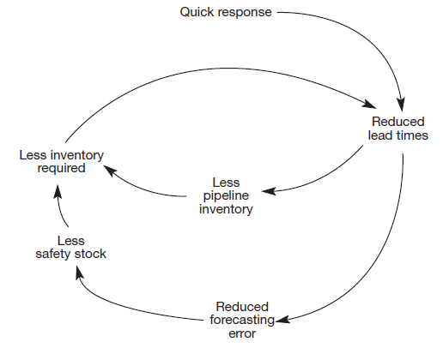
‘Quick response’ logistics
Quick response system can trigger a ‘virtuous circle’ in logistics

Slide 21
‘Quick response’ logistics
Quick response systems have begun to emerge in the fashion and apparel industry where the costs of traditional inventory-based systems based upon buyers’ prior purchase decisions (in effe
One such reported case is the linkage through shared information of the US textile company Milliken with the Seminole Manufacturing Companyct a ‘push’ system) can be considerable.
Another case from the US is provided by the chain of retail fashion stores, The Limited.

Slide 22
Production strategies for quick response
As the demand by all partners in the supply chain for a quick response increases, the greater will be the pressure placed upon manufacturing to meet the customer’s needs for variety in shorter and shorter time-frames.
Whilst zero lead times are obviously not achievable, the new focus on flexible manufacturing systems (FMS) has highlighted the possibility of substantial progress I
Whilst zero lead times are obviously not achievable, the new focus on flexible manufacturing systems (FMS) has highlighted the possibility of substantial progress in this direction.n this direction.
The Japanese, not surprisingly, have led the way in developing techniques for set-up time reduction. ‘Single minute exchange of die’, or SMED,
fundamental shift away from the economies of scale model,

Slide 23
Production strategies for quick response
Many companies are now seeking to construct supply chains to enable them to support a marketing strategy of mass customisation.
Often this can be achieved by postponing the final configuration or assembly of the product until the actual customer requirement is known – a strategy pursued by Dell and Hewlett Packard, for example.
In other cases high technology in the form of computer-aided design/computer-aided manufacturing (CAD/CAM) can provide the means for this mass customisation.

Slide 24
Logistics systems dynamics
One of the major advantages of moving to QR and synchronous supply chain strategies is that, by reducing lot quantities and increasing the rate of throughput in the logistics system, modulations in the level of activity in the pipeline can be reduced.
Logistics systems are prone to what has been called the ‘Bullwhip’ or ‘Forrester Effect’,
The bullwhip effect is a distribution channel phenomenon in which demand forecasts yield supply chain inefficiencies. It refers to increasing swings in inventory in response to shifts in consumer demand as one moves further up the supply chain.

Slide 25
Logistics systems dynamics
Dynamics.Forrester defined industrial dynamics as:
The study of the information feedback characteristics of industrial activity to show how organizational structure, amplification (in policies) and time delays (in decisions and returns) interact to influence the success of the enterprise. It treats the interactions between the flows of information, money, orders, materials, personnel, and capital equipment in a company, an industry or a national economy.
Using a specially developed computer simulation language, DYNAMO, Forrester built a model of a production/distribution system involving three levels in the distribution channel: a retailer’s inventory, a distributor’s inventory and a factory inventory. Each level was interconnected through information flows and flows of goods.

Slide 26
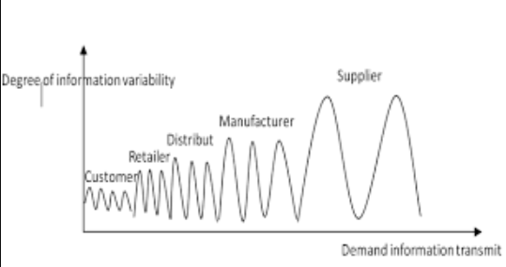
bullwhip effect

Slide 27
Logistics systems dynamics
Explaining Bullwhip effect with an Example
Consumers suddenly start buying a certain food product in higher amounts than usual. Instead of regular 100 units sold, a supermarket suddenly sells 150. The supermarket puts an order to the supplier for 200 units, just in case the supply keeps increasing. The supplier only deals with bulk orders monthly, so they order enough to supply 250 units weekly for the next month. The manufacturer then has more than doubled demand for the next month and scales their production capacity to cope with it. In the end, 5 times more goods are produced than the actual consumer demand, which will massively drive prices down across the supply chain.

Slide 28
Explaining Bullwhip effect
different causes lead to this effect.
Some of them include unbalanced estimations from the part of distributors, order batching at some points of the supply chain, and often the lack of communication and sync between the different links of the chain. However, a big issue is on the manufacturer side in industries where production scaling is a slow process.
Soybean production, Brazil produces 36% of all the global supply (By 2020).
Growing of plants and animals for consumption, especially in the production of fresh and perishable goods, is notably a process that cannot simply be upscaled or downscaled in quick response times.

Slide 29
Logistics systems dynamics
What becomes apparent from this modelling of complex systems is that small disturbances in one part of the system can very quickly become magnified as the effect spreads through the pipeline.
companies that are heavy spenders on trade promotions (e.g. special discounts, incentives, etc.) do not realise what the true costs of such activities are
first instance there is the loss of profit through the discount itself, and then there is the hidden cost of the disturbance to the logistics system. Consider first the loss of profit.
One study found that for these reasons only 16 per cent of promotions were profitable, the rest only ‘bought sales’ at a loss.

Slide 30
Logistics systems dynamics
The second impact of promotional activity on profit is the potential it provides for triggering the ‘acceleration effect’ and hence creating a Forrester-type surge throughout the logistics pipeline. This is because in most logistics systems there will be ‘leads and lags’, in other words the response to an input or a change in the system may be delayed. For example, the presence of a warehouse or a stock holding intermediary in the distribution channel can cause a substantial distortion in demand at the factory. This is due to the ‘acceleration effect’, which can cause self-generated fluctuations in the operating characteristics of a system.

Slide 31
Logistics systems dynamics
So if weekly demand were 100 units for a particular item the target starting inventory would be 300 (i.e. 100 × 3).
Now let us assume that as a result of a promotion demand increases by 10 per cent to 110.
This means that the system would place an order to bring the next week’s starting inventory up to 330 (i.e. 110 × 3).
So the reorder quantity would have to be 140 (i.e. the 110 units sold to consumers plus the extra 30 required to meet the new starting level).
In this particular case an increase in consumer demand of 10 per cent leads to a one-off increase in demand on the supplier of 40 per cent!
If in the next period consumer demand were to fall back to its old level then the same effect would happen in reverse.

Slide 32
Logistics systems dynamics
Figure 9 illustrates the lagged and magnified effect of such promotional activity upon the factory. It can be imagined that such unpredictable changes in production requirements add considerably to the unit costs of production.

Slide 33
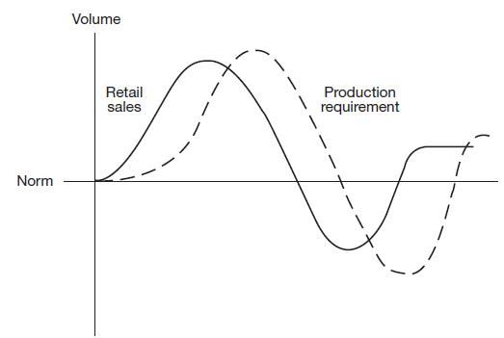
Logistics systems dynamics
The impact of promotional activity upon production requirement

Slide 34
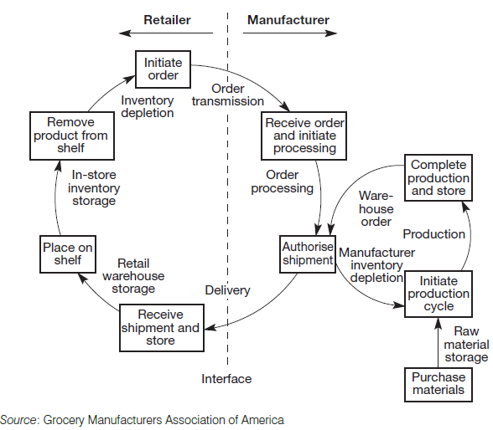
Logistics systems dynamics
Figure 10 Grocery industry delivery system order cycle

Slide 35
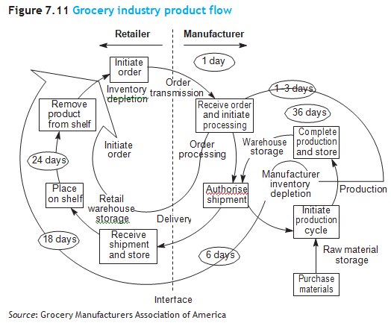
Logistics systems dynamics
Figure 7.11 Grocery industry product flow

Slide 36
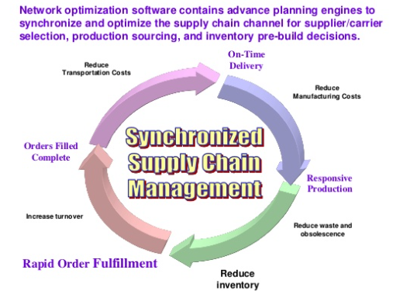
Synchronomous supply chain management

